Slide 1
Why Learning to Code is so Important
Jacob Pawlak - Computer Science/Linguistics

Slide 2
Where is Code?
Where do we even see code?
What uses code?

Slide 3
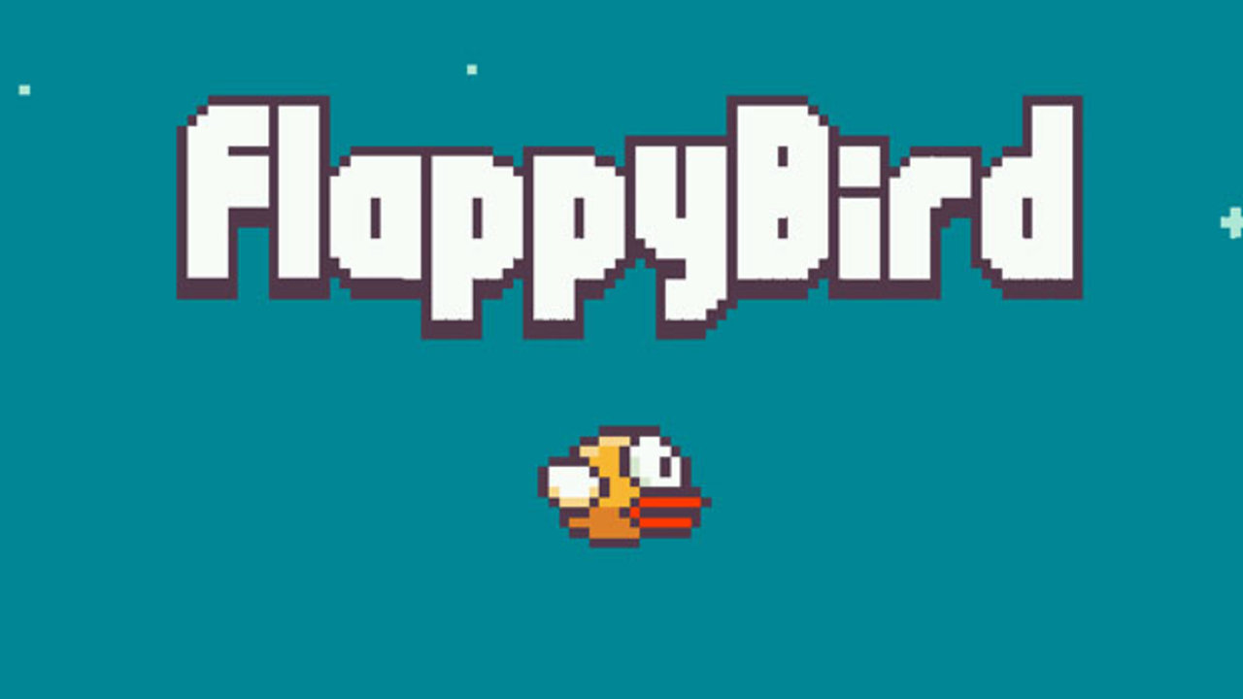

Slide 4
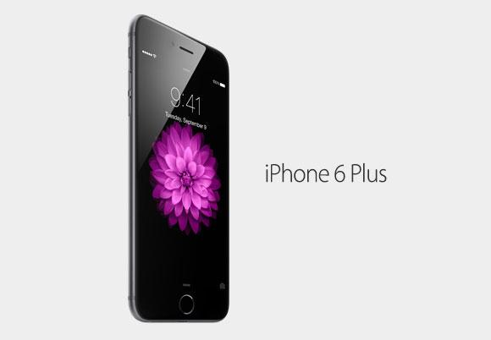

Slide 5


Slide 6
What does code look like?
Python Demos
teamLab5.py
lab9Team4.py

Slide 7
Why would you want to learn code
Last year, U.S. News ranked “Software Developer” and two other Computer Science Jobs in the Top 10 Best Careers to have.
Coding can be practical.
Coding can be fun!

Slide 8
Think about this…
Would you rather use paper and a pen to sum up all of the even numbers from 0 to 10,000,000…
Or write 4 lines of code to do it in like a second?
counter = 0
for i in range(0, 10000000, 2):
counter += i
print(counter)

Slide 9
Programming can be fun!
Game Design
Software Engineering
Robotics
Apple and Facebook and Google (oh my)
All these jobs can be fun!

Slide 10
What can you do to start programming?
Start right now! Or whenever you get home.
www.code.org Hour of code!
Find a book or just google a beginner programming language - Python, Scheme, Ruby, JavaScript
www.kidsruby.com - A great introduction to Ruby

